Slide 1
Using Games to Understand Tradeoffs in Designing Across Technology Domains
Bowen Yan, Jeff Alstott, Jianxi Luo
and You!

Slide 2


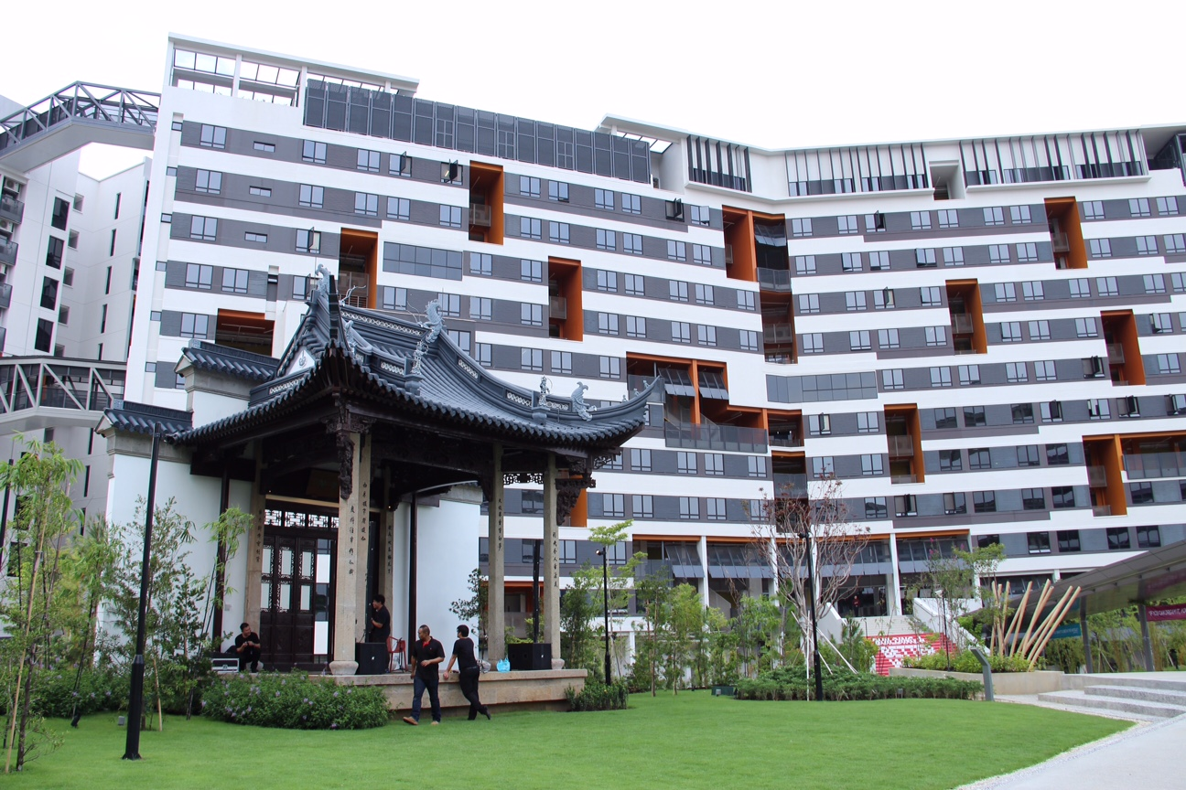




Slide 3
Go here now:
innogps.sutd.edu.sg/game.html
OR
bit.ly/28SmaRN

Slide 4

innogps.sutd.edu.sg/game.html
bit.ly/28SmaRN

Slide 5
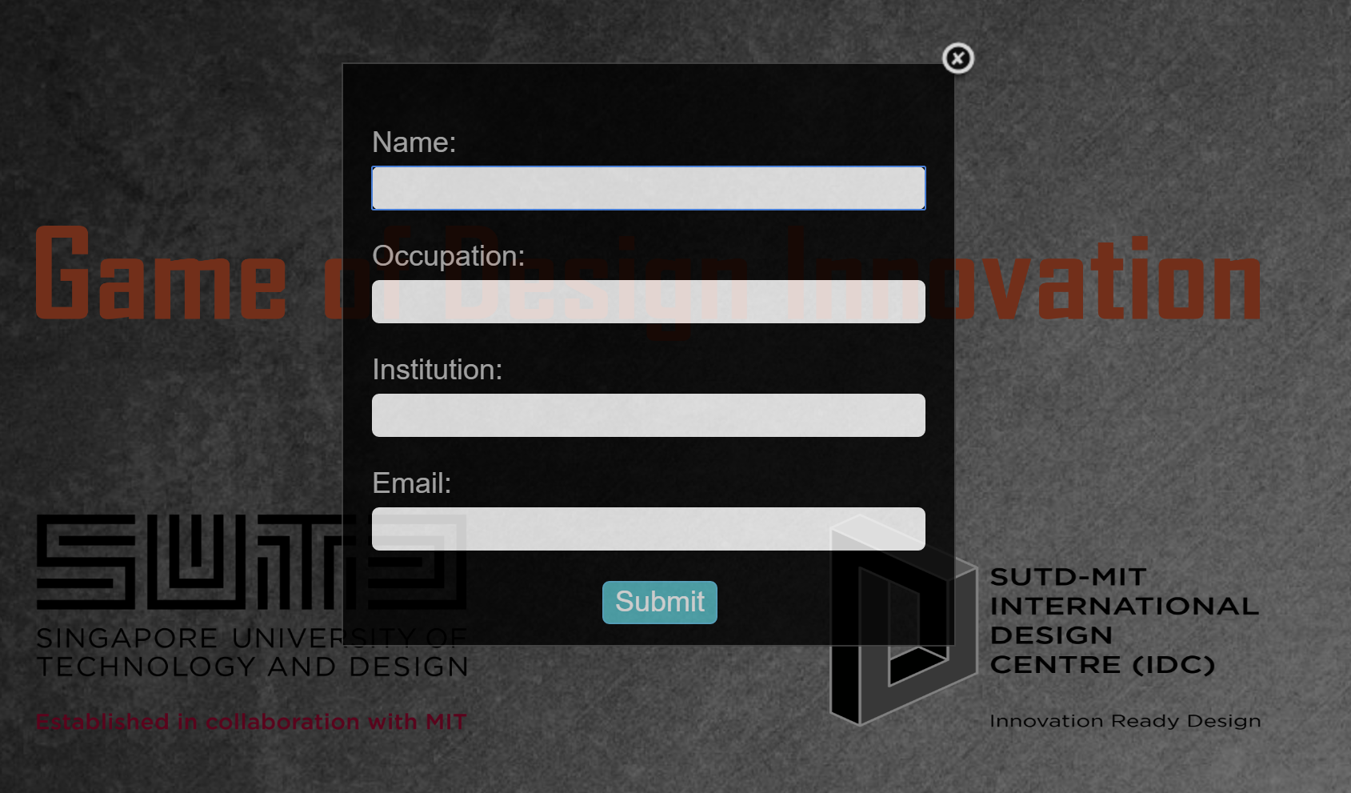
innogps.sutd.edu.sg/game.html
bit.ly/28SmaRN

Slide 6
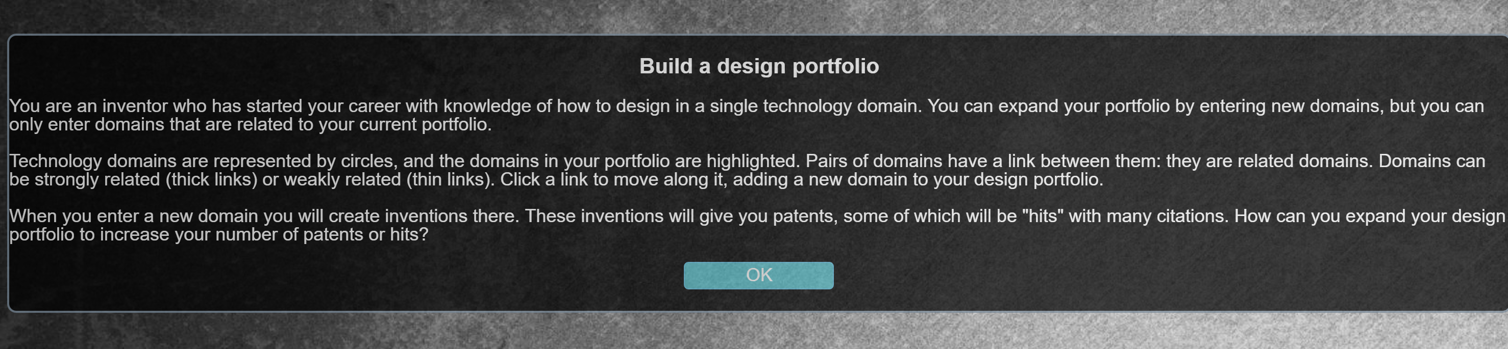
innogps.sutd.edu.sg/game.html
bit.ly/28SmaRN

Slide 7



Slide 10
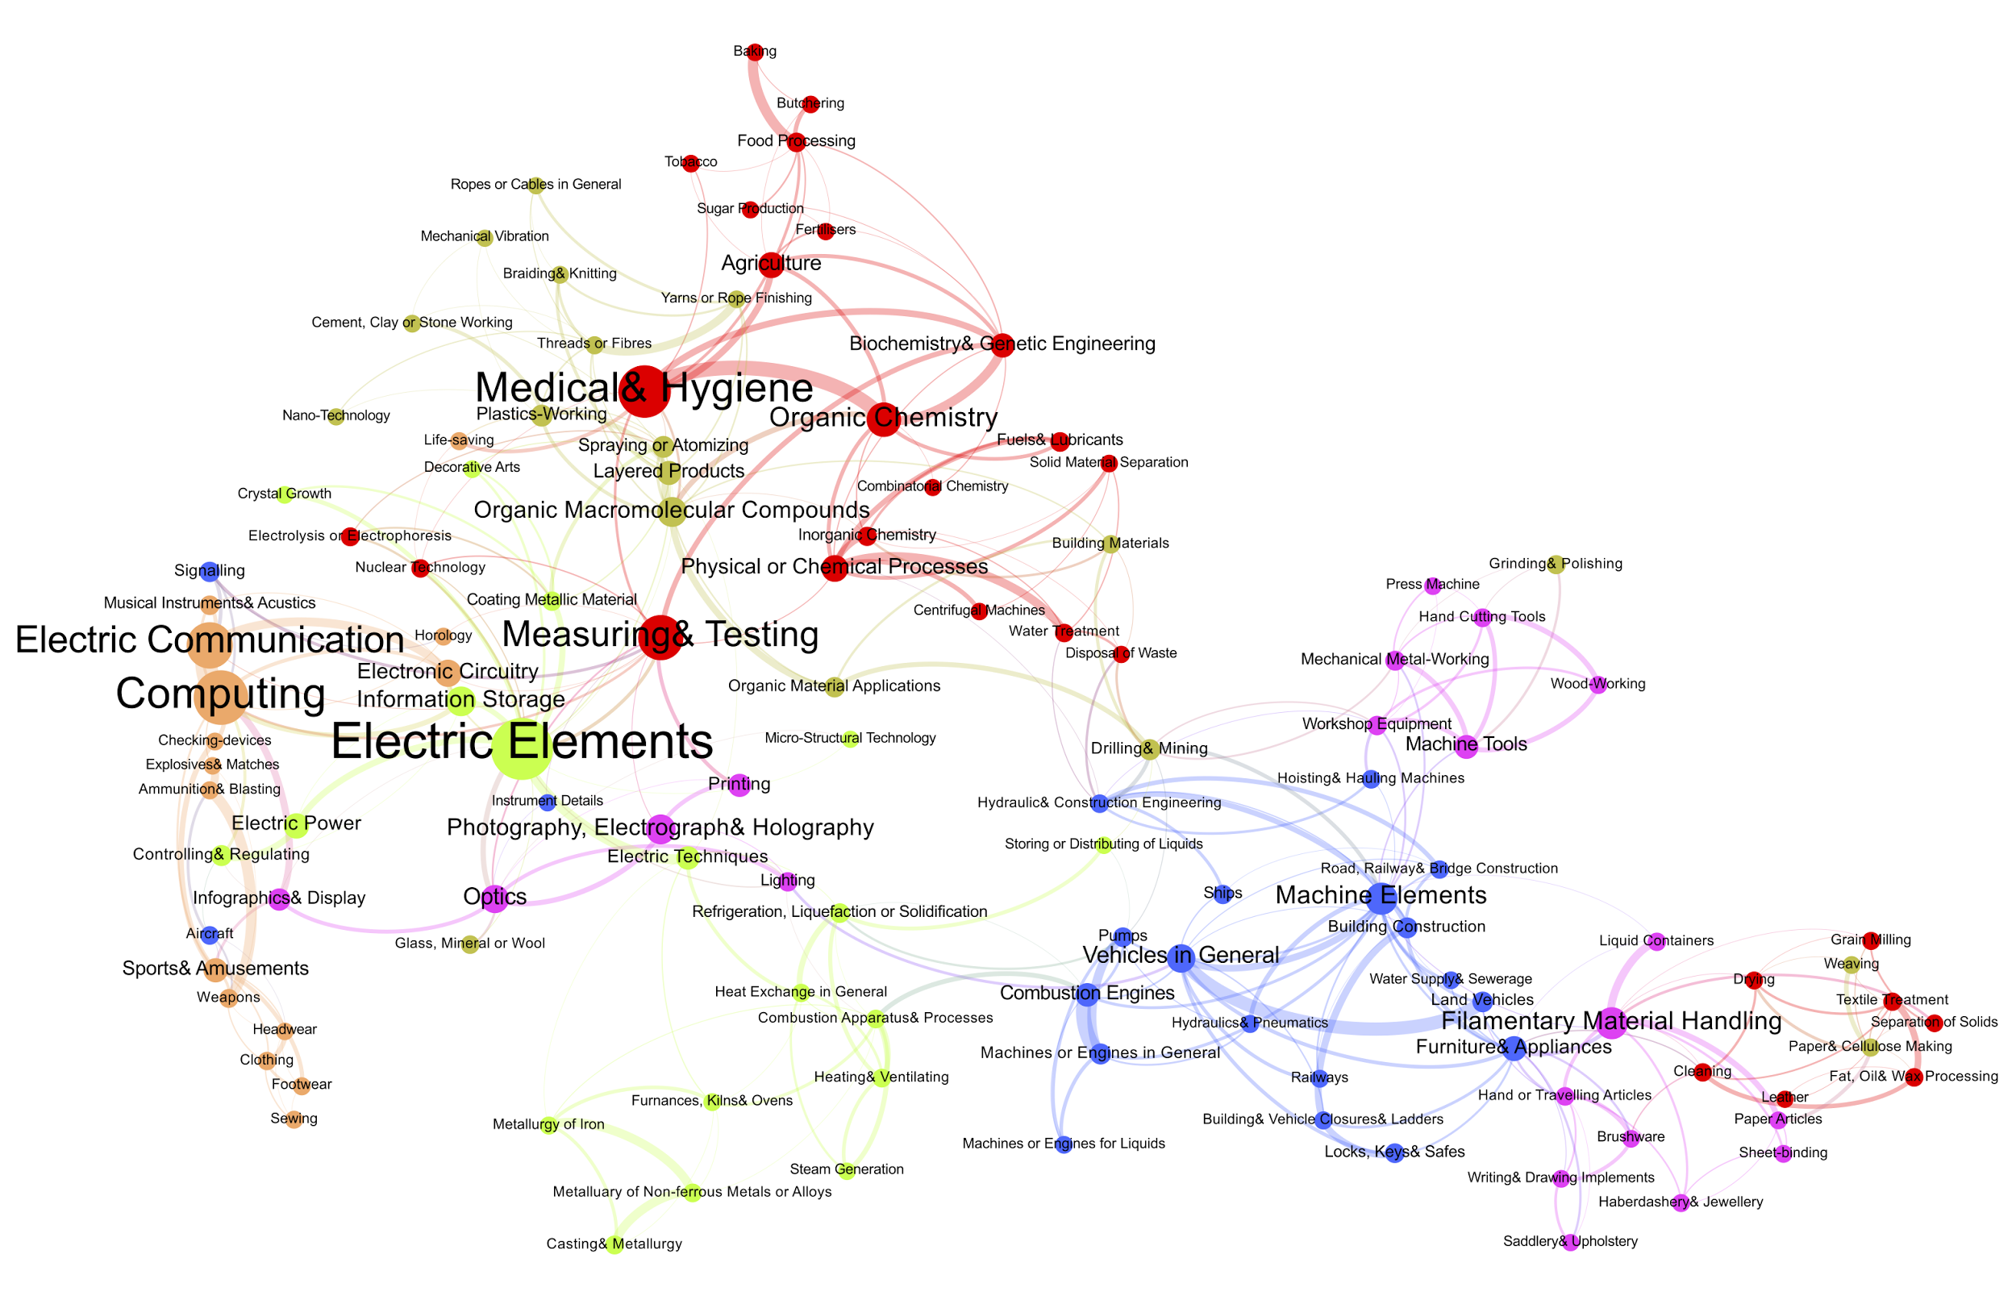
Alstott et al. 2016 arXiv:1509.07285, in press at Scientometrics

Slide 11



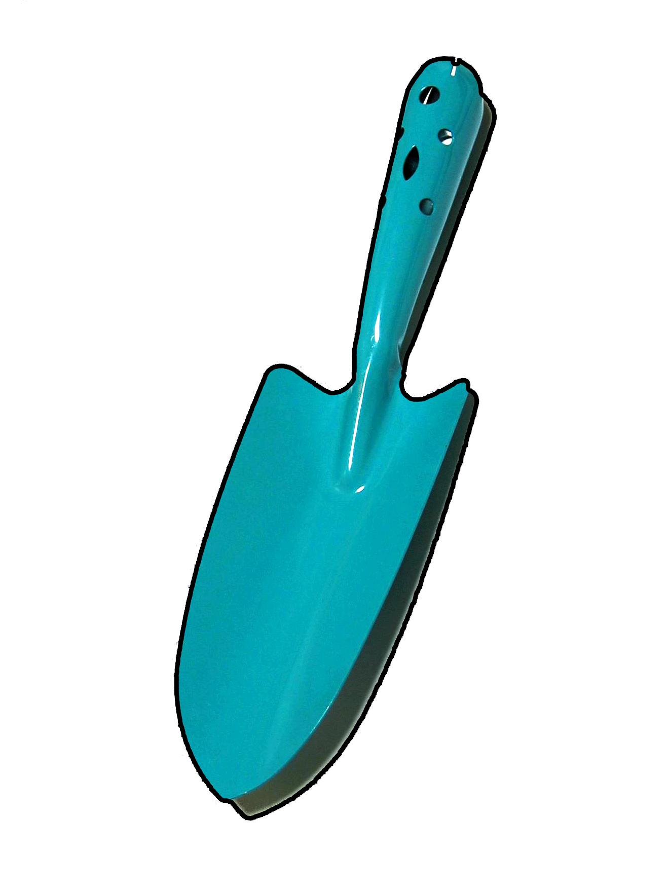



Previous Patents
Future Patents?

Slide 12
Is this smart?

Slide 13
YOU made tradeoffs
when you played the game!

Slide 14
Using Games to Understand Tradeoffs in Designing Across Technology Domains
Bowen Yan, Jeff Alstott, Jianxi Luo
and You!

